Slide 1
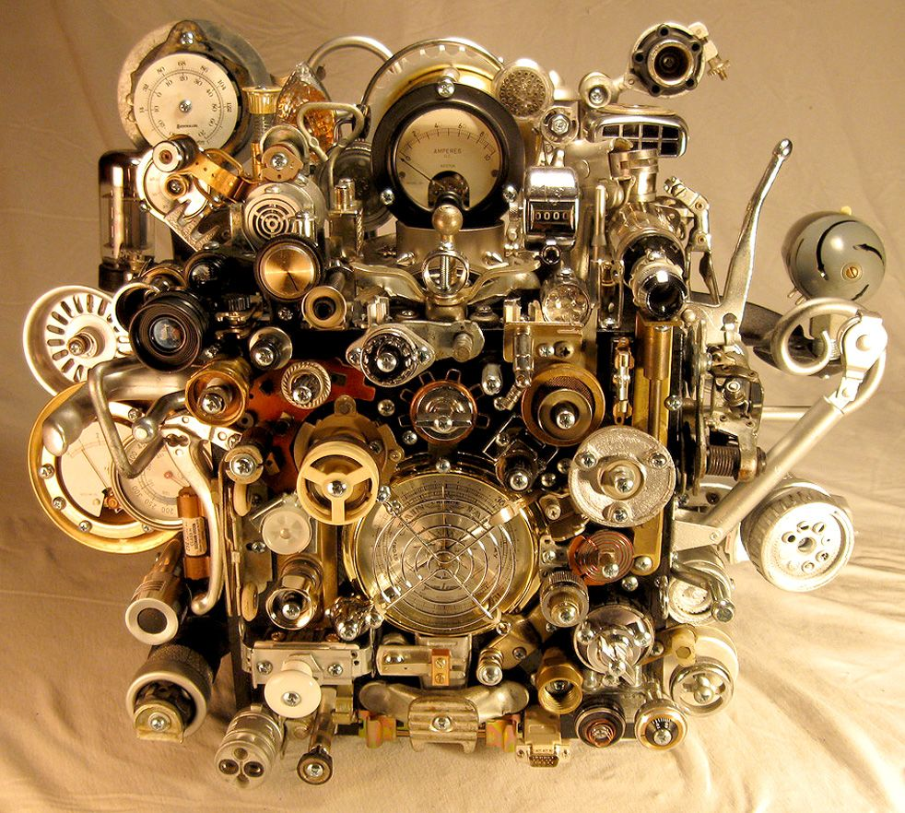
The E-Commerce Project: Searching for Business Relevant Insights
The E-Commerce Project: Searching for Business Relevant Insights
Diana Jaffé
March 15th, .2021
Diana Jaffé
March 15th, .2021

Slide 2

Brief Project Description
The Phases
HTML basics
Web Scraping from Amazon.com
Data cleaning in Python, data cleaning in Python, data cleaning in Python, data cleaning in Python, data cleaning in Python, data cleaning in Python, data cleaning in Python, data cleaning in Python…
Finishing data cleaning
Changing to preprocessed data
Data cleaning in mySQL, data cleaning in mySQL , data cleaning in mySQL , data cleaning in mySQL , data cleaning in mySQL , data cleaning in mySQL , data cleaning in mySQL , data cleaning in mySQL…
SQL Queries
Graphs in Python / Plotly

Slide 3



What Did the Given Data Look Like?
Challenges – Obsticles - Chances.

Slide 4
The Provided Sales Data Set
Challenges
After Cleaning
After Cleaning
574,105 Records in total
2,515 Records had neither a product name, nor ASIN or price
Huge amount of seeming duplicates – that in fact weren‘t duplicates
Why did mySQL calculate the (not rounded!) float format 13,99 + 8,99 = 22.979999542236328 instead of 22,98?
There are still a few unsolved questions…
530,140 Records after cleaning
20,633 Distinct invoice numbers
Customers from 38 Countries

Slide 5
Data / Information
Unique ASINS Per Product Category
 | In Total Data | In Sold Products | %
Keyboards | 3,353 | 967 | 28.8
Mouses | 2,151 | 696 | 32.4
Monitors | 398 | 149 | 37.4
Processors | 1,189 | 445 | 37.4
Cameras | 2,464 | 861 | 34.9
Smartphones | 3,237 | 950 | 29.3
Unique | 12,431 | 4,067

Slide 6

Which further insights did I gain so far?
(There‘s still much more to explore.)

Slide 7

What‘s in the Future?
In Terms of Insights, KPI, Business Decisions?

Slide 8
Recommendations For The Next Steps
Explore the data further and more granular.
Which products on stock are not being sold?
Which markets / countries are worthwile to invest into?
Check for deviating customer / buying behaviour in Corona times - and try to evaluate the impacts on future purchases!
How can marketing investments be adjusted best to the purchasing behaviour of customers resp. to stimulate it?
Many important business questions cannot be answered through this data, e. g. about the total market potential, competitors, optimization of product offers etc.

Slide 9

There‘s much ahead...

Slide 10

Thank you!

